Slide 1
Approach
For
Jobathon: Credit Card Lead Prediction
By - : Ayan Dogra
CSE-3rd year
MSIT

Slide 2
Basic Implementations
Data Exploration and Analysis
Feature Engineering
Model Preparation
Model Evaluation and Predictions

Slide 3
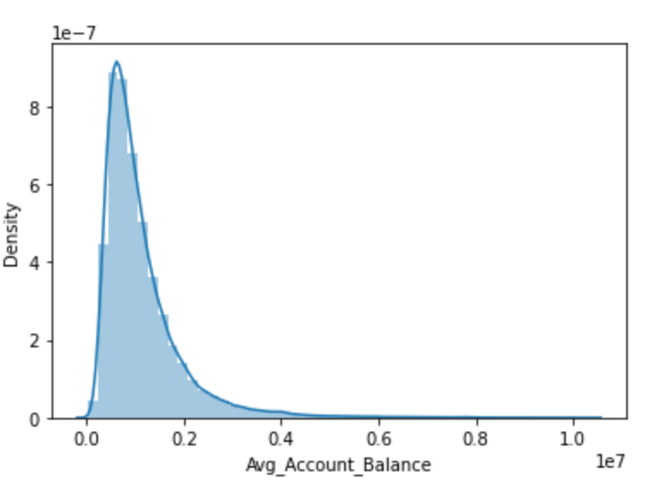
DATA ANALYSIS
Importing necessary libraries
Some basic visualizations for the data
Checking for Null values in the column. It can be seen that null values are present only in a single column which is handled in feature engineering.
Checking for values absent in train data but present in test data. No such value can be discovered.
Dividing the columns into Categorical and Numerical columns. Where only 2 columns are Numerical, while 7 columns can be seen as Categorical.
Distribution of Avg_Account_Balance shows a skewed behaviour. This will be handles in feature engineering.

Slide 4
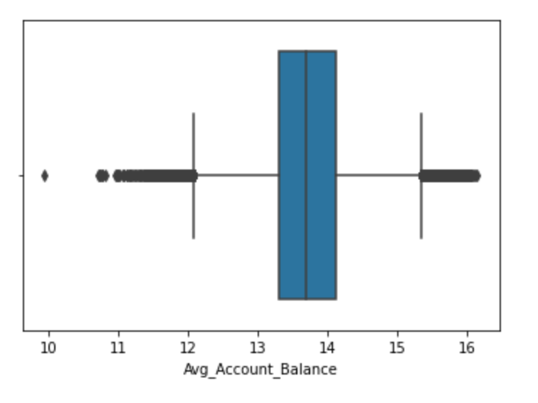
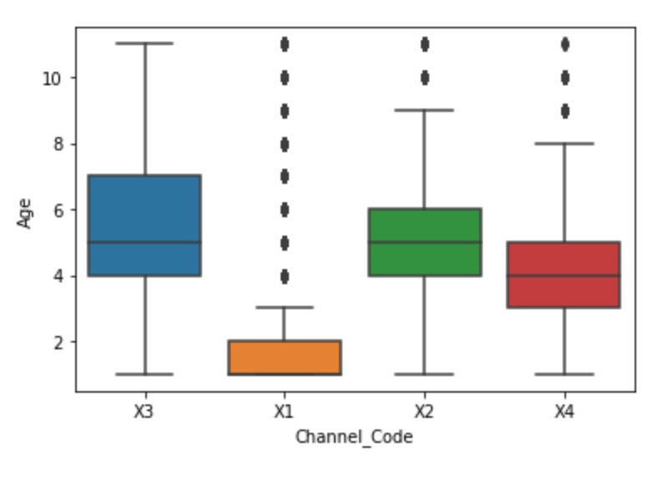
FEATURE ENGINEERING
Treating the null values of Credit_Product column. Replacing the NaN values with a new ‘UNK’ parameter since the value is currently unknown to us. In addition, replacing it with ‘Yes’ as well as ‘No’ is observed to be yielding a poor result in comparison.
Dropping unwanted column of ID, since it doesn’t contribute to model building.
Removing skewness from Avg_Account_Balance using log transformation.
Removing outliers from Avg_Account_Balance using box plot and quantiles.
Removing unwanted outliers from Channel_Code based on Age using boxplot technique.
Scaling Age and Vintage columns using StandardScaler.
Dropping Region_Code since it is a low information variable.
Converting Categorical variables to Dummies.

Slide 5
MODEL PREPARATION
Various models were testing, out of which LGBMClassifier performed with the best results using cross-validation scores.
Parameter tuning the Model using Optuna.
The best split for the model was found to be 0.2, with Stratified Sampling.
Best parameters discovered for the model can be found below.
The validation accuracy at the end of training reached 0.875724 on auc_roc_score.

Slide 6
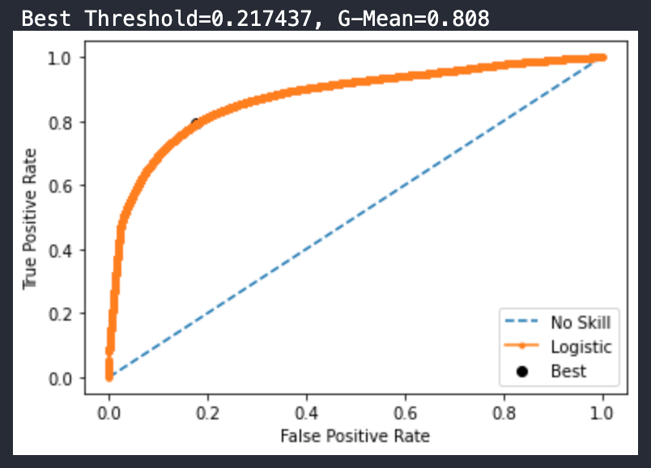
MODEL EVALUATION AND PREDICTIONS
AUC-ROC Curve was prepared using the validation data.
Threshold for the model turns out to be 0.217437 as the Best Threshold
Feature Importance Graph is drawn at the end to depict the importance of various features in the model.
All the Numerical columns held high importance values, while Occupation_Salary and Channel_Code_X2 were among the top in categorical columns. Channel_Code_X3 and Channel_Code_X4 turned out to be the least important in the entire group of columns.

Slide 7
Thanks !!

